Slide 1
Artificial Intelligence
Slides taken from bcssp10.files.wordpress.com/2013/02/

Slide 2
Clustering

Slide 3
Lecture Outline
What is Clustering
Supervised and Unsupervised Classification
Types of Clustering Algorithms
Most Common Techniques
Areas of Applications
Discussion

Slide 4
Clustering - Definition
Process of grouping similar items together
Clusters should be very similar to each other but…
Should be very different from the objects of other clusters/ other clusters
We can say that intra-cluster similarity between objects is high and inter-cluster similarity is low
Important human activity --- used from early childhood in distinguishing between different items such as cars and cats, animals and plants etc.

Slide 5
Supervised and Unsupervised Classification
What is Classification?
What is Supervised Classification/Learning?
What is Unsupervised Classification/Learning?
SOM – Self Organizing Maps

Slide 6
Types of Clustering Algorithms
Clustering has been a popular area of research
Several methods and techniques have been developed to determine natural grouping among the objects
Jain, A. K., Murty, M. N., and Flynn, P. J., Data Clustering: A Survey. ACM Computing Surveys, 1999. 31: pp. 264-323.
Jain, A. K. and Dubes, R. C., Algorithms for Clustering Data. 1988,
Englewood Cliffs, NJ: Prentice Hall. 013022278X

Slide 7
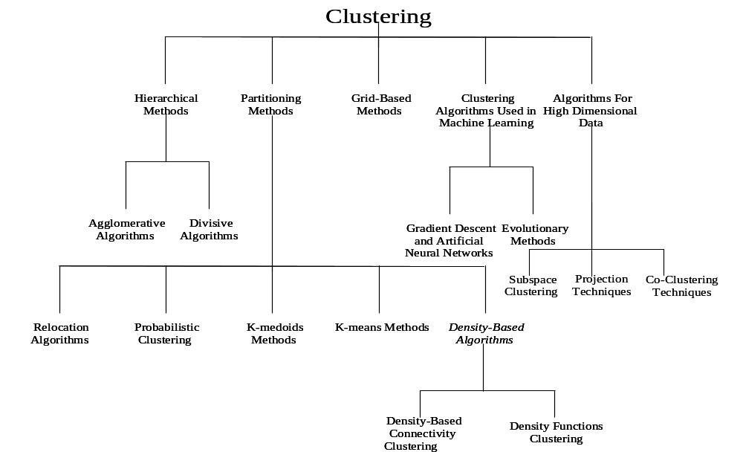
Types of Clustering Algorithms

Slide 8
Classification vs. Clustering
Classification:
Supervised learning:
Learns a method for predicting the instance class from pre-labeled (classified) instances

Slide 9
Clustering
Unsupervised learning:
Finds “natural” grouping of instances given un-labeled data

Slide 10
Clustering Evaluation
Manual inspection
Benchmarking on existing labels
Cluster quality measures
  distance measures
  high similarity within a cluster, low across clusters

Slide 11
The Distance Function
Simplest case: one numeric attribute A
  Distance(X,Y) = A(X) – A(Y)
Several numeric attributes:
  Distance(X,Y) = Euclidean distance between X,Y
Are all attributes equally important?
  Weighting the attributes might be necessary

Slide 12
Simple Clustering: K-means
Works with numeric data only
Pick a number (K) of cluster centers (at random)
Assign every item to its nearest cluster center (e.g. using Euclidean distance)
Move each cluster center to the mean of its assigned items
Repeat steps 2,3 until convergence (change in cluster assignments less than a threshold)

Slide 13
K-means example, step 1
k₁
Y
Pick 3
initial
cluster
centers
(randomly)
k₂
k₃
X

Slide 14
K-means example, step 2
k₁
Y
k₂
Assign
each point
to the closest
cluster
center
k₃
X

Slide 15
K-means example, step 3
k₁
k₁
Y
Move
each cluster center
to the mean
of each cluster
k₂
k₃
k₂
k₃
X

Slide 16
K-means example, step 4
Reassign
points
closest to a different new cluster center
Q: Which points are reassigned?
k₁
Y
k₃
k₂
X

Slide 17
K-means example, step 4 …
k₁
Y
A: three points with animation
k₃
k₂
X

Slide 18
K-means example, step 4b
k₁
Y
re-compute cluster means
k₃
k₂
X

Slide 19
K-means example, step 5
k₁
Y
k₂
move cluster centers to cluster means
k₃
X

Slide 20
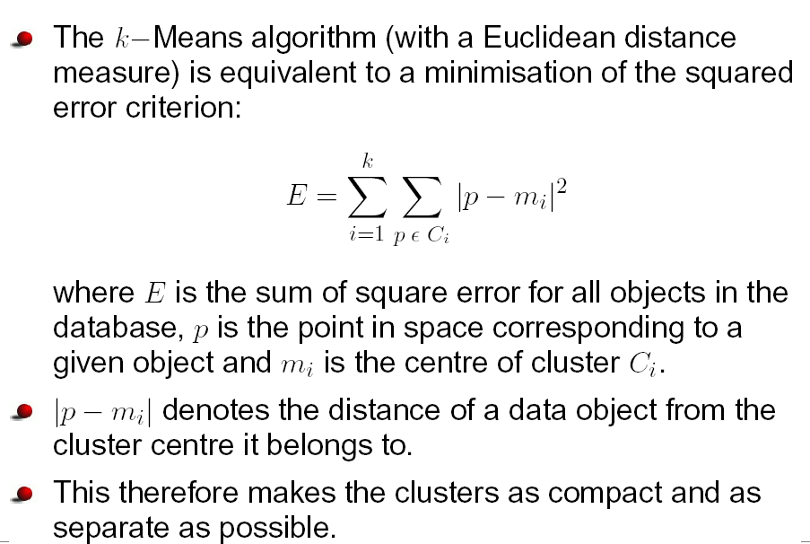
Squared Error Criterion

Slide 21
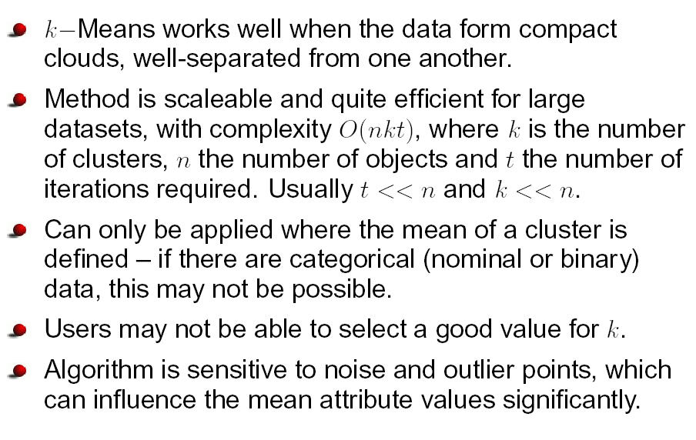
Pros and cons of K-Means

Slide 22
K-means variations
K-medoids – instead of mean, use medians of each cluster
  Mean of 1, 3, 5, 7, 9 is
  Mean of 1, 3, 5, 7, 1009 is
  Median of 1, 3, 5, 7, 1009 is
  Median advantage: not affected by extreme values
For large databases, use sampling
5
205
5

Slide 23
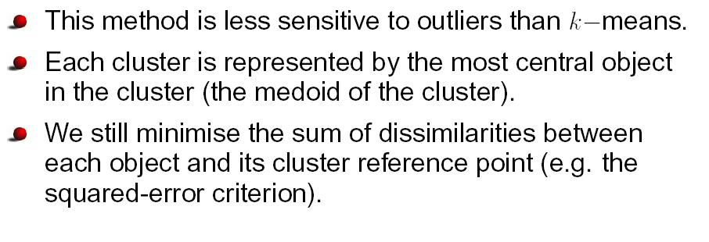
k-Medoids

Slide 24
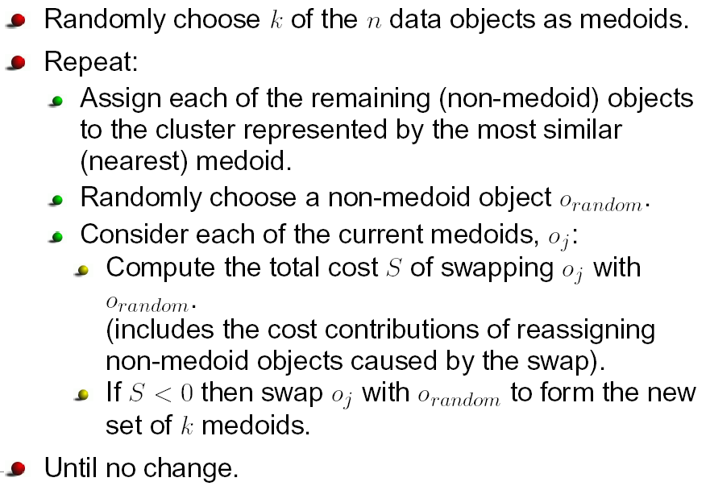
The k-Medoids Algorithm

Slide 25
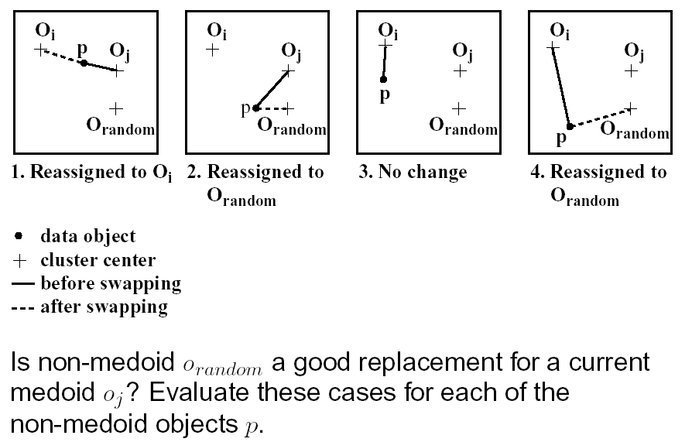
Evaluating Cost of Swapping Medoids

Slide 26
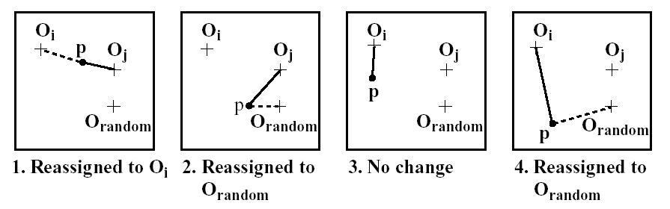
Evaluating Cost of Swapping Medoids

Slide 27
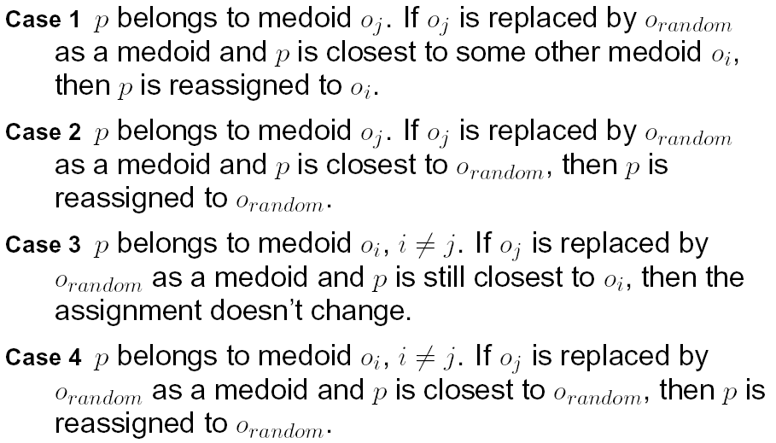
Four Cases

Slide 28
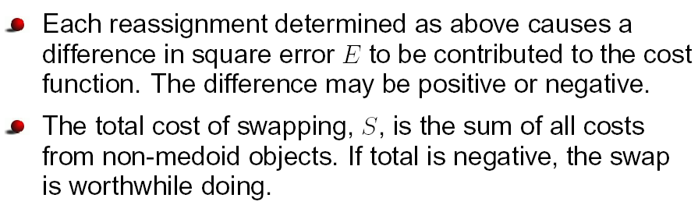
Total Cost of Swap

Slide 29
K-means clustering summary
Advantages
Simple, understandable
items automatically assigned to clusters
Disadvantages
Must pick number of clusters before hand
All items forced into a cluster
Too sensitive to outliers since an object with an extremely large value may substantially distort the distribution of data

Slide 30
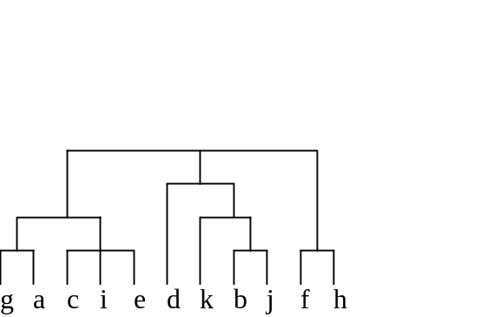
Hierarchical clustering
Agglomerative Clustering
  Start with single-instance clusters
  At each step, join the two closest clusters
  Design decision: distance between clusters
Divisive Clustering
  Start with one universal cluster
  Find two clusters
  Proceed recursively on each subset
  Can be very fast
Both methods produce a
dendrogram

Slide 31
Partial Supervision of Clustering
S-Lower
Upper
Lout
S-upper
Nominal
Nominal
Nominal
Nominal
S-Lower
Nominal
S-Lower
S-Lower
H-upper
A two dimensional image of supervised clusters

Slide 32
Partial Supervision of Clustering
Upper
Lout
Nominal
S-Lower
S-upper
Nominal
Nominal
S-Lower
Nominal
Nominal
H-upper
S-Lower
S-Lower
A two dimensional image of supervised clusters (real case)

Slide 33
Partial Supervision of Clustering
Disputed Data Point
5
4
5
3
4
2
3
1
2
1
A two dimensional image of the different zones of overlapping clusters who both claim a data point (More than two clusters claiming a point is also common)

Slide 34
Research Problems
Effective and Efficient methods of Clustering
Scalability
Handling different types of data
Handling complex multidimensional data
Complex shapes of clusters
Subspace Clustering
Cluster overlapping etc.

Slide 35
Examples of Clustering Applications
Marketing: discover customer groups and use them for targeted marketing and re-organization
Astronomy: find groups of similar stars and galaxies
Earth-quake studies: Observed earth quake epicenters should be clustered along continent faults
Genomics: finding groups of gene with similar expressions
…

Slide 36
Clustering Summary
unsupervised
many approaches
  K-means – simple, sometimes useful
    K-medoids is less sensitive to outliers
  Hierarchical clustering – works for symbolic attributes
  Can be used to fill in missing values

Slide 37
Questions
?

